Slide 1
Prof. Dr. Muna H. AL-Saeed

Slide 2
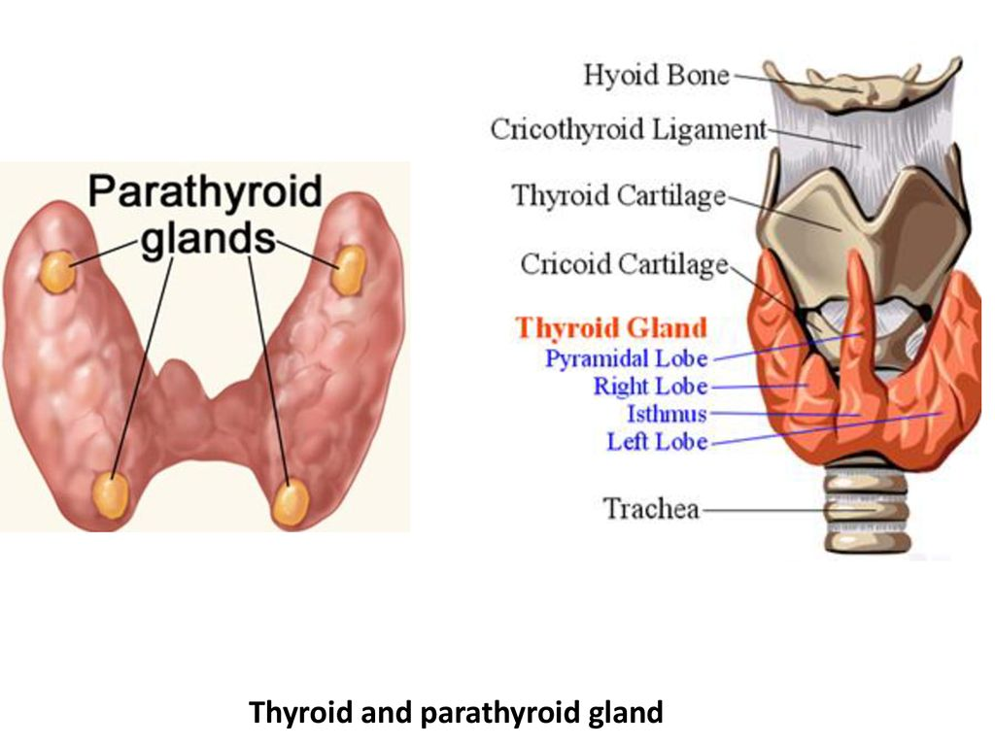

Slide 9
DISORDERS OF THE PARATHYROID GLANDS:
DISORDERS OF THE PARATHYROID GLANDS
Disorders of the Parathyroid Glands:
Disorders of the Parathyroid Glands Maintenance of calcium, phosphate and magnesium homeostasis is under the influence of two polypeptide hormones; parathyroid hormone(PTH), and calcitonin (CT), as well as a sterol hormone, 1,25 dihydroxy cholecalciferol (1,25 (OH) 2 D 3 .

Slide 10
Disorders of the Parathyroid Glands:
Disorders of the Parathyroid Glands These hormones regulate the flow of minerals in and out of the extracellular fluid compartments through their actions on intestine, kidneys, and bones .
Disorders of the Parathyroid Glands:
Disorders of the Parathyroid Glands The PTH acts directly on the bones and kidneys and indirectly on the intestine through its effect on the synthesis of 1,25 (OH) 2 D 3 . Its production is regulated by the concentration of serum ionized calcium. Lowering of the serum calcium levels will induce an increased rate of parathyroid hormone secretion
Disorders of the Parathyroid Glands:
Disorders of the Parathyroid Glands Calcitonin is released by the “C” cells (parafollicular cells in the thyroid gland) in response to small increases in plasma ionic calcium. It acts on the kidney and bones to restore the level of calcium to just below a normal set point which in turn inhibits secretion of the hormone.

Slide 11
Disorders of the Parathyroid Glands:
Disorders of the Parathyroid Glands Calcitonin is therefore the physiological antagonist of PTH . The two hormones act in concert to maintain normal concentration of calcium ion in the extracellular fluid.
Disorders of the Parathyroid Function:
Disorders of the Parathyroid Function Primary hyperparathyroidismis due to excessive production of PTH by one or more of hyperfunctioning parathyroid glands. This leads to hyprcalcemia which fails to inhibit the gland activity in the normal manner. Hyperparathyroidism
Disorders of the Parathyroid Function:
Disorders of the Parathyroid Function The cause of primary hyperparathyroidism is unknown. A genetic factor may be involved. The clonal origin of most parathyroid adenomas suggests a defect at the level of the gene controlling the regulation and/or expression of parathyroid hormone. Hyperparathyroidism

